Slide 1


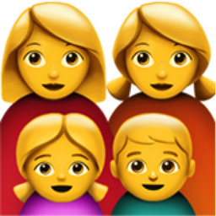


J.E.A.J.!
TEAM PICTURE
Joëlle Strijk
Annebel de Kok
Joran Backx
Esther van Brakel
PERSOLAISED THE SHOP EXPIRIENCE
Machine Learning
TECHNOLOGIES
Big Data
AR

